Slide 1
BHP 2016 Formula Rate True-Up Meeting
June 19, 2017

Slide 2
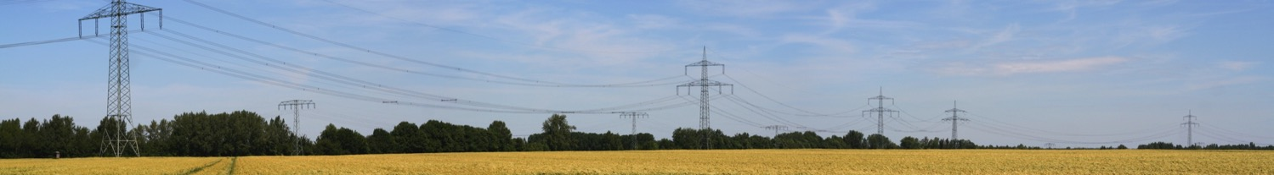
Agenda
Introductions
CUS Transmission System Overview
Black Hills Power’s Formula Rate Protocols
Discuss the 2016 Annual True-Up
Where to Find Information and be Engaged
Questions & Comments

Slide 3
CUS Transmission System
The Common Use System (CUS) is a joint transmission system owned by Basin Electric Power Cooperative, Black Hills Power, Inc. and Powder River Energy Corporation.
The CUS has filed with the FERC a joint open-access transmission tariff that provides transmission service over these combined assets that consist of 230 kV and limited 69 kV transmission facilities within areas of Southwestern South Dakota and Northeastern Wyoming.
The CUS is made up of approximately 980 circuit miles

Slide 4
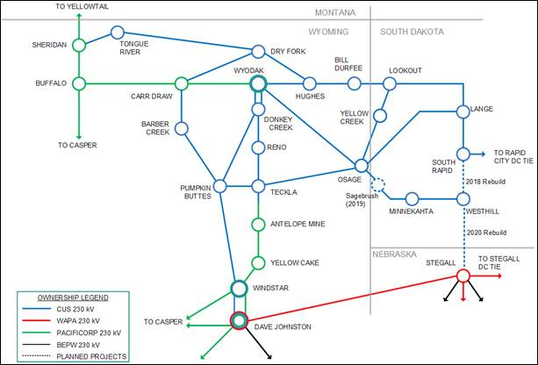
Common Use System
10-Year Transmission Plan

Slide 5
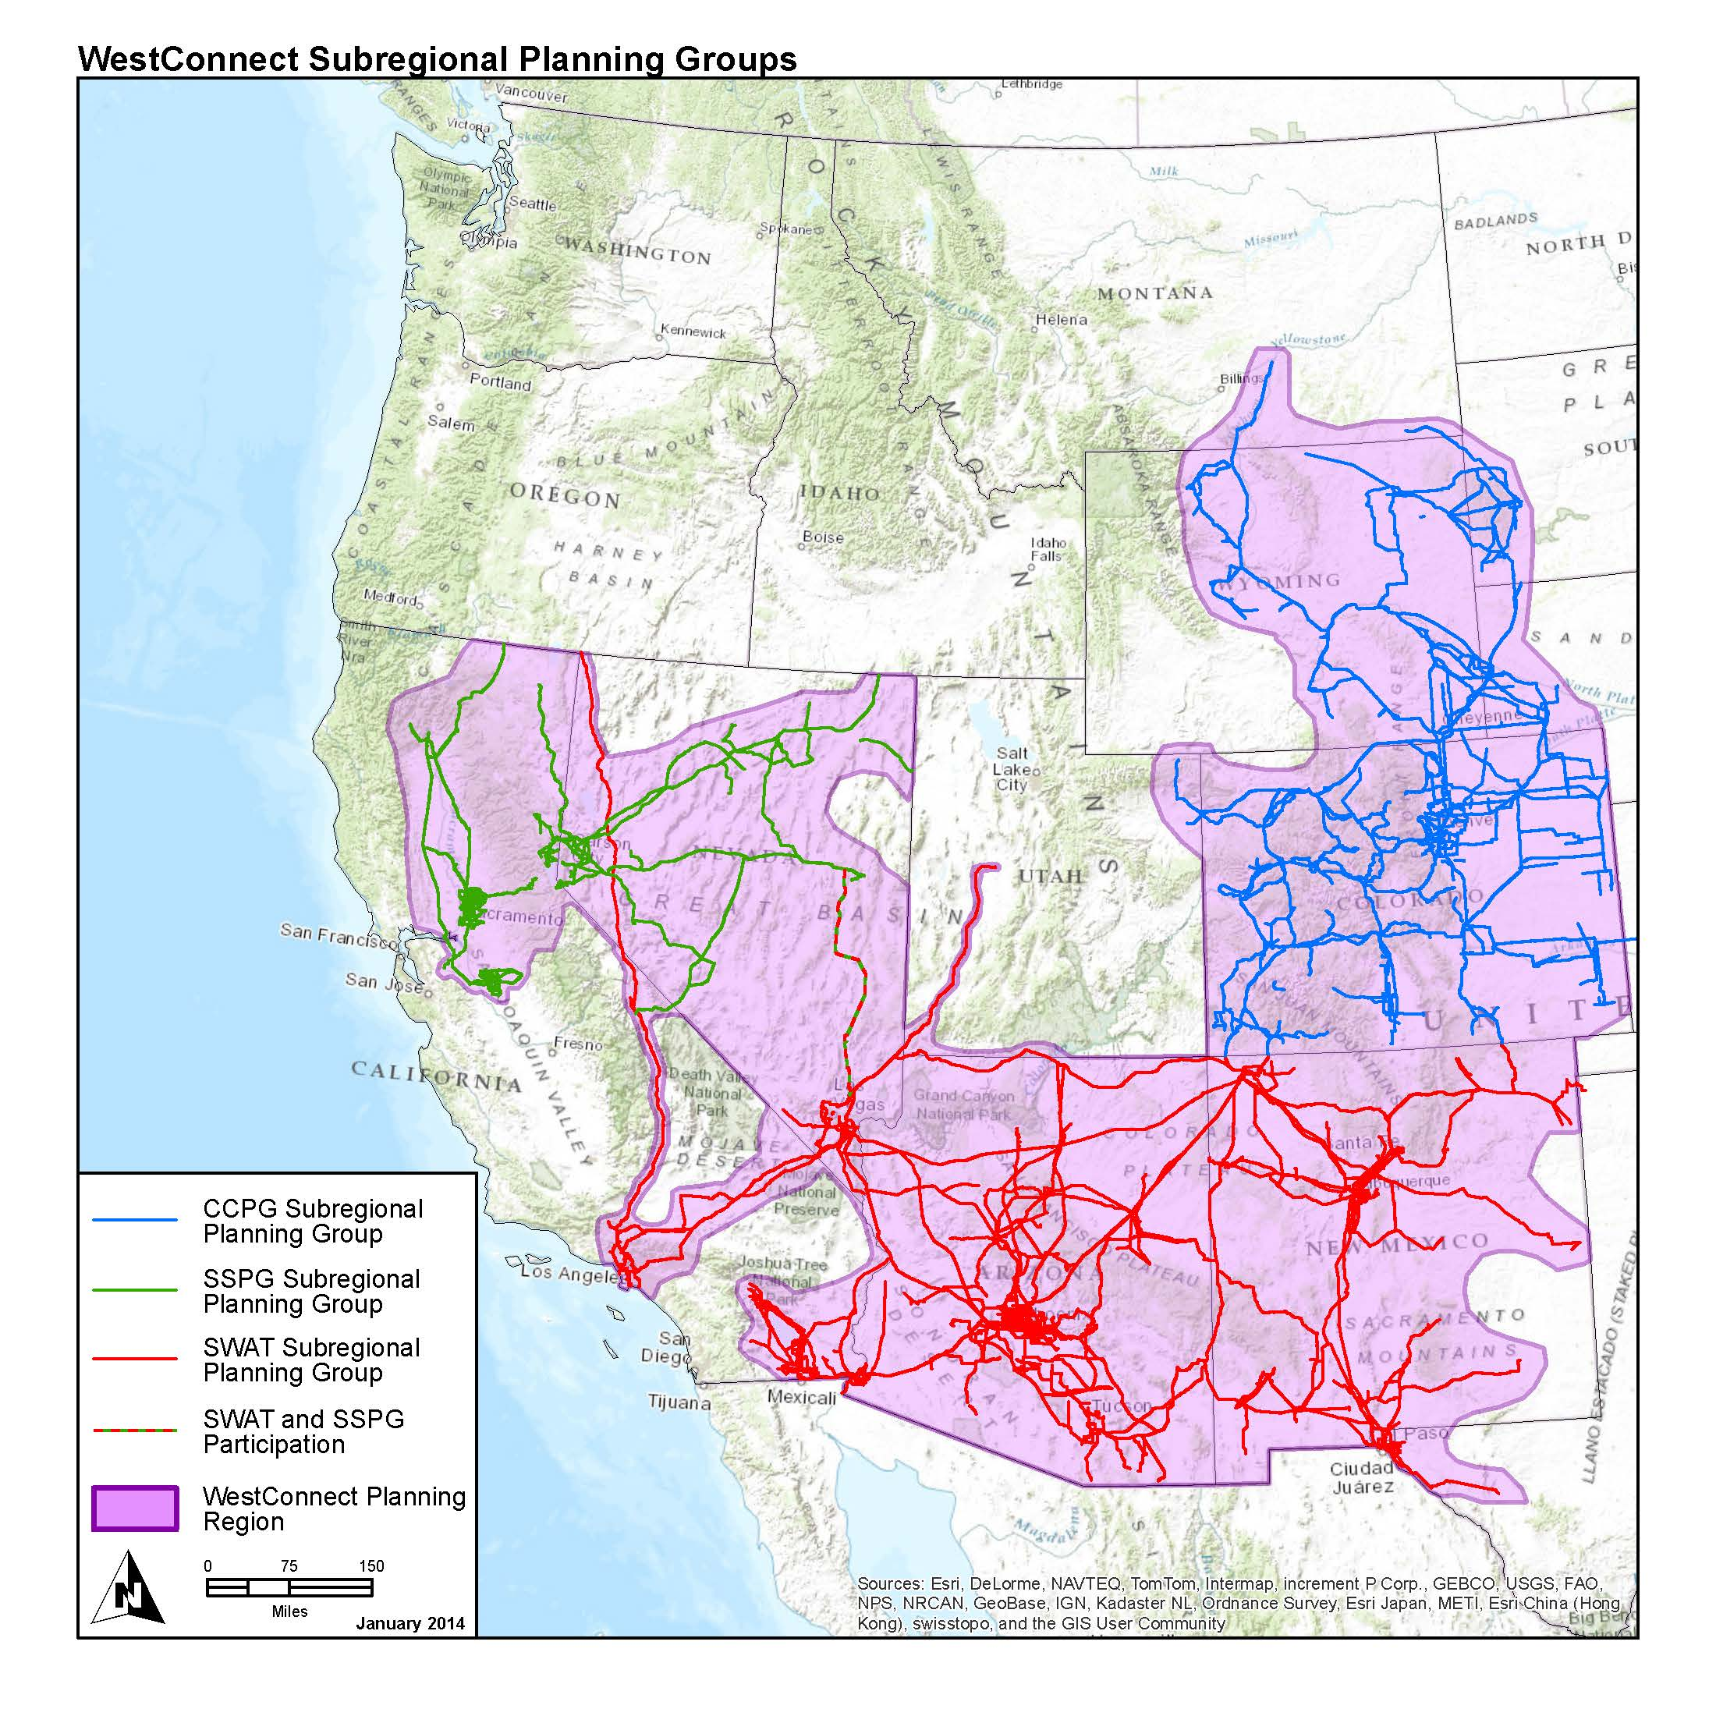
Where We Are in the West
BHBE / Common Use System
CCPG—Colorado Coordinated Planning Group
SSPG—Sierra Subregional Planning Group
SWAT—Southwest Area Transmission

Slide 6

Formula Rate Protocols
In July 2014, the Federal Energy Regulatory Commission (FERC) requested that Black Hills update its formula rate protocols
The updates were needed to:
    Provide clarification on who can participate in the information exchange
    Increase transparency
    Create challenge procedures
  Black Hills Revised its tariff and the new formula rate protocols went into effect January 1, 2015

Slide 7

Summary of Key Drivers
Revenue Requirement
Decrease in total revenue requirement of ($1,082,369)
Drivers of decrease :
    Delay in-service of Teckla-Osage 230kV Line
    Delay in-service of Osage-Lange 230kV line
    Change in Accounting for payroll taxes
O&M Increase drivers
    Misc. Maintenances for 230KV
    Other Misc. Maintenances for System Control

Slide 8
2016 Revenue Actual vs. Estimated

Slide 9

How to be Engaged
We invite our transmission customers to sign up to receive notices related to the Projected Net Revenue Requirement and Annual True-Up. A notification will be sent by email whenever there is an update. These notifications are also posted on our OASIS site. https://www.oasis.oati.com/BHBE/index.html
To sign up for the notices go to our website www.blackhillsenergy.com. In the list on the left click on In Your Neighborhood. Next click on Transmission & Distribution then Transmission Rates. Under More Information click on the link Sign up for notices. Key in your email address and click Subscribe.
If you have any questions please contact us on our transmission line at 605-721-2220 or email Transmissionservice@blackhillscorp.com.

Slide 10
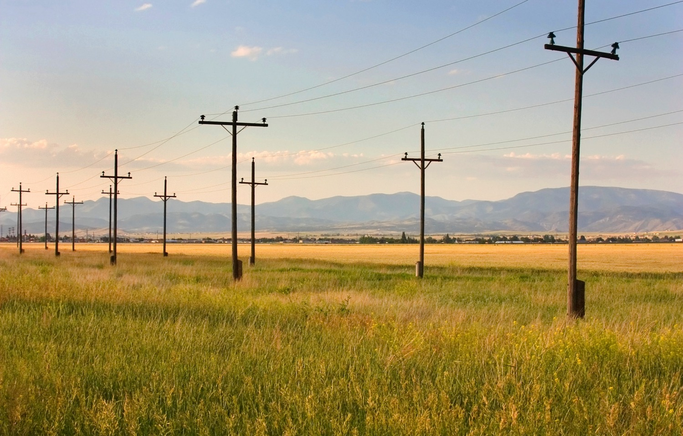
Questions

Slide 11

Comments / Suggestions
Eric East
Tariff and Contract Administration
Transmissionservice@blackhillscorp.com
(605) 721-2220

